Slide 1
The Whole Picture: Working With Children and Autism While Looking Through the Lenses of Encouragement, Life Tasks and the Crucial Cs
Presented by
Laura Williams and Robert Saxner

Slide 2
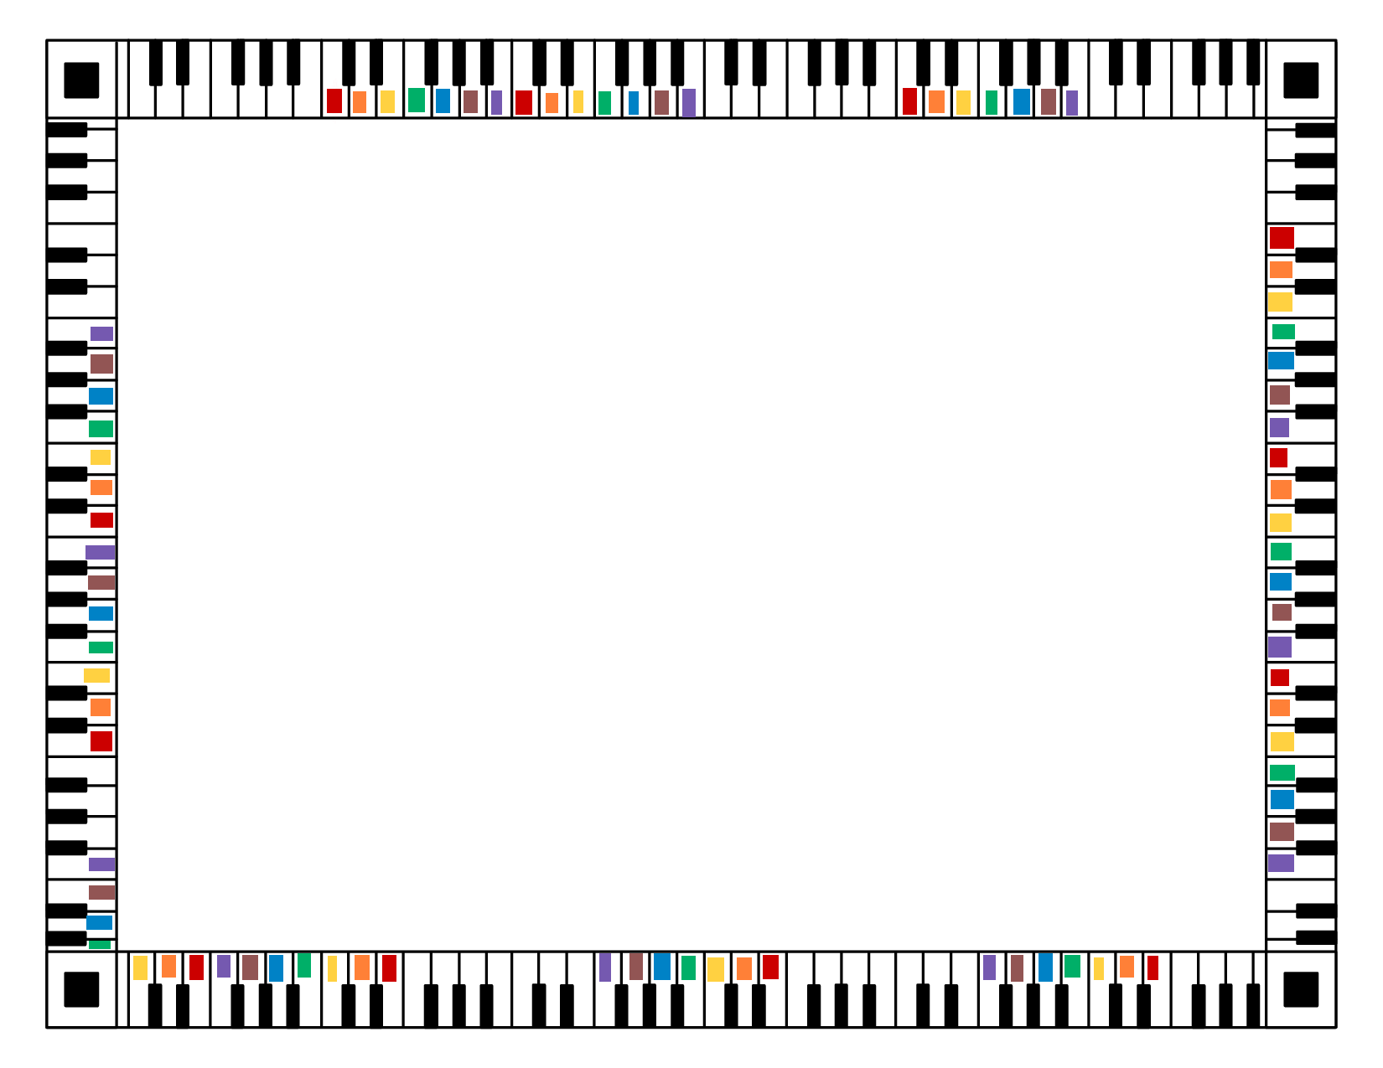
WHOLE STEPS
An Autism-Friendly Music Program
Every week in a small group setting, students learn piano and note-reading basics in a format that incorporates the use of color, appealing to the visual strengths common to autistic students. Latter portions of the class are spent expressing through singing in solfege with hand signs and becoming acquainted with classical literature through movement to music.

Slide 3
WHOLE STEPS
An Autism-Friendly Music Program

Slide 4
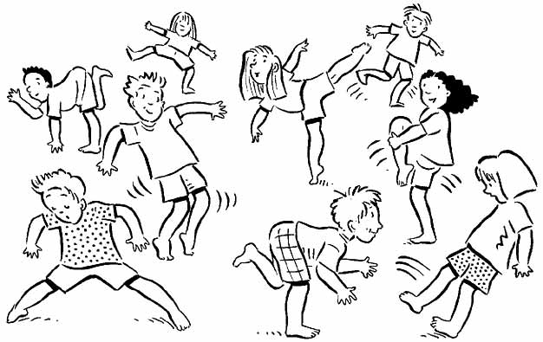
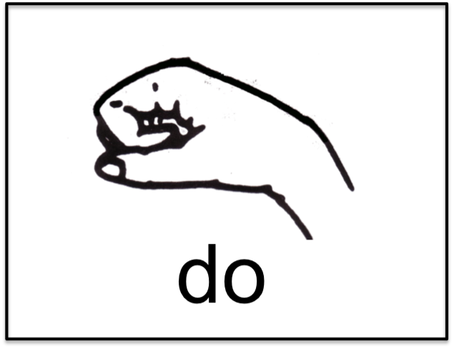
WHOLE STEPS
An Autism-Friendly Music Program

Slide 5
An educator’s most important task... is to see to it that no child is discouraged at school and that a child who enters school already discouraged regains his self-confidence through the school and his teacher. (Ansbacher & Ansbacher, 1956).
Alfred Adler and subsequent Adlerians consider encouragement a crucial aspect of human growth and development. (Watts, 2013).

Slide 6
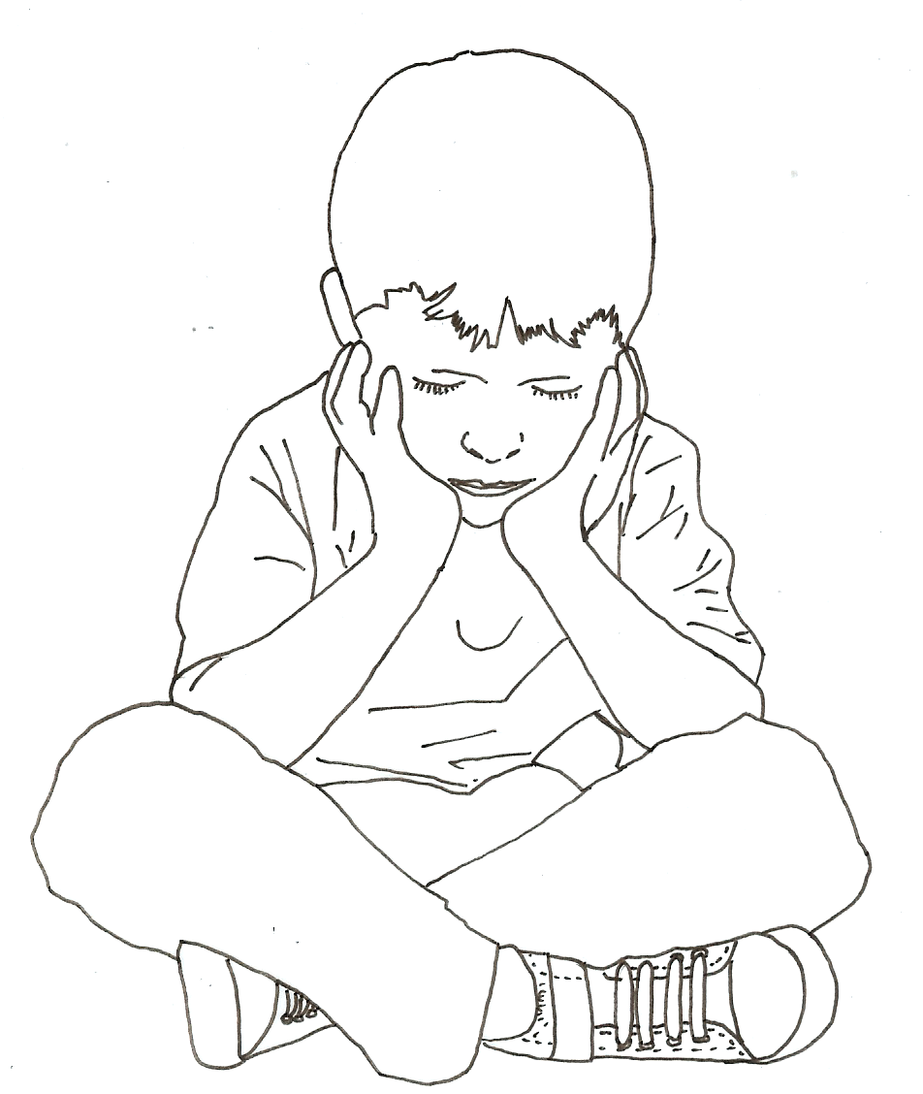
Autism discouraging words:
Disorder, disease, incurable, needs to be eradicated, pitiful, burden, defective, puzzling, delayed, poor social skills, stubborn, problems, difficulties, low functioning, severe, disruptive, bad, defective, different, misbehaving, awkward, fixated,
weaknesses, uninterested, miserable,
limited, obsessed, don’t deserve to live,
preoccupied, impaired, incessant,
unusually intense, dulled, immature,
less important than others,
no future, cause parents devastation,
stress, desperation, fear, frustration,
financial problems, guilt, and grief,
you need to be excluded,
you don’t fit in, you don’t belong.

Slide 7
Encouragement
A
way of
being with others
Merely an
Adlerian
technique
Encouragement is often misunderstood as merely an ‘Adlerian technique.’ Actually, encouragement is a way of being with others, and Adlerians view counseling as a process of encouragement.
Encouragement is the therapeutic modeling of social interest. (Watts, 2013).

Slide 8
Encouragement skills:
Accepting clients unconditionally and without judgment
Demonstrating concern for clients through active listening, respect and empathy
Focusing on clients’ strengths, assets and abilities, including identifying past successes and communicating confidence in the same
Helping clients to generate perceptual alternatives for discouraging fictional beliefs and oppressive narratives
Helping clients distinguish between what they do and who they are (deed vs. doer)
Focusing on clients’ efforts and progress
Communicating affirmation and appreciation to clients
Helping clients see the humor in life (Watts, 2013).

Slide 9
Scarves: not only for magicians
Harmless, promotes full expression, reduces inhibition,
alternative to hand-holding, helps regulate sensory, safe space

Slide 10
world
Adult tasks of life
world
community
community
Child tasks of life
Romantic
partner
friends
caregiver
friends/
siblings
αὐτός
teachers
work relationships

Slide 11
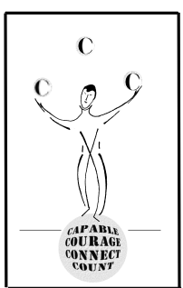
THE CRUCIAL Cs
Amy Lew, Ph.D. & Betty Lou Bettner, Ph.D.

Slide 12
The need to CONNECT The need to feel CAPABLE The need to believe you COUNT The need to develop COURAGE

Slide 13
Discouragement - Dreikurs’ goals of children’s misbehavior
ATTENTION
POWER
REVENGE
AVOIDANCE

Slide 14
Behaviors commonly associated with autism
STIMMING
OBSESSION
AVOIDANCE/WITHDRAWAL
LACK OF EYE CONTACT

Slide 15
Mis-behaviors or adaptive behaviors?
SELF-SOOTHING
ORGANIZING
DEGREE OF INTEREST
SELF-REGULATING

Slide 16
Mind-body connection
OVER-OR-UNDER-STIMULATION
(SENSORY ISSUES)
MEDICATION
DEGREE OF ANXIETY

Slide 17
Case study
WRITING IN THE AIR -
MISBEHAVIOR OR
ADAPTIVE BEHAVIOR?

Slide 18
Case study
WRITING IN THE AIR -
HOW TO USE
THE CRUCIAL Cs

Slide 19
In conclusion
Shulman: “Like everyone else, the child with autism has a unique position in the family. The Adlerian will look at how the child with autism affects the rest of the family in terms of relationships in the family constellation such as the effect on siblings, parents, and parents relationships to other siblings and will look to see how all the individuals in the family will respond to the uniqueness of the individual child.”

Slide 20
fin

Slide 21
References
Adler, A. (1956). The individual psychology of Alfred Adler (H. L.
Ansbacher & R. R. Ansbacher, Eds.). New York, NY: Basic Books.
Watts, R. E. (2013, April). Reflecting as if. Counseling Today,
55(10), 48-53. http://ct.counseling.org/2013/04/reflecting-as-if/
Watts, R. E., & Pietrzak, D. (2000). Adlerian “encouragement”
and the therapeutic process of solution-focused brief therapy.
Journal of Counseling and Development, 78, 442-447.

